Slide 1
Why Data Preprocessing?
Data in the real world is dirty
  incomplete: lacking attribute values, lacking certain attributes of interest, or containing only aggregate data
    e.g., occupation=“ ”
  noisy: containing errors or outliers
    e.g., Salary=“-10”
  inconsistent: containing discrepancies in codes or names
    e.g., Age=“42” Birthday=“03/07/1997”
    e.g., Was rating “1,2,3”, now rating “A, B, C”
    e.g., discrepancy between duplicate records
Data Mining: Concepts and Techniques

Slide 2
Why Is Data Preprocessing Important?
No quality data, no quality mining results!
  Quality decisions must be based on quality data
    e.g., duplicate or missing data may cause incorrect or even misleading statistics.
  Data warehouse needs consistent integration of quality data
Data extraction, cleaning, and transformation comprises the majority of the work of building a data warehouse
Data Mining: Concepts and Techniques

Slide 3
Major Tasks in Data Preprocessing
Data cleaning
  Fill in missing values, smooth noisy data, identify or remove outliers, and resolve inconsistencies
Data integration
  Integration of multiple databases, data cubes, or files
Data transformation
  Normalization and aggregation
Data reduction
  Obtains reduced representation in volume but produces the same or similar analytical results
Data discretization
  Part of data reduction but with particular importance, especially for numerical data
Data Mining: Concepts and Techniques

Slide 4

Forms of Data Preprocessing
Data Mining: Concepts and Techniques

Slide 5
Chapter 2: Data Preprocessing
Why preprocess the data?
Descriptive data summarization
Data cleaning
Data integration and transformation
Data reduction
Discretization and concept hierarchy generation
Summary
Data Mining: Concepts and Techniques

Slide 6
Mining Data Descriptive Characteristics
Motivation
  To better understand the data: central tendency, variation and spread
Data dispersion characteristics
  median, max, min, quantiles, outliers, variance, etc.
Numerical dimensions correspond to sorted intervals
  Data dispersion: analyzed with multiple granularities of precision
  Boxplot or quantile analysis on sorted intervals
Dispersion analysis on computed measures
  Folding measures into numerical dimensions
  Boxplot or quantile analysis on the transformed cube
Data Mining: Concepts and Techniques

Slide 7
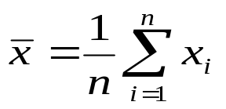

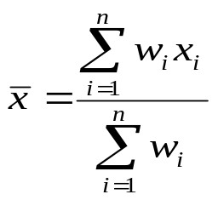
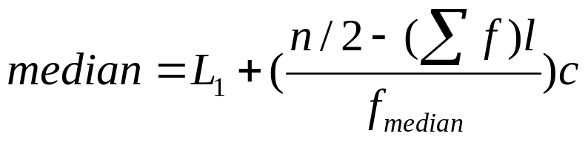
Measuring the Central Tendency
Mean (algebraic measure) (sample vs. population):
  Weighted arithmetic mean:
  Trimmed mean: chopping extreme values
Median: A holistic measure
  Middle value if odd number of values, or average of the middle two values otherwise
  Estimated by interpolation (for grouped data):
Mode
  Value that occurs most frequently in the data
  Unimodal, bimodal, trimodal
  Empirical formula:
Data Mining: Concepts and Techniques

Slide 8



Symmetric vs. Skewed Data
Median, mean and mode of symmetric, positively and negatively skewed data
Data Mining: Concepts and Techniques

Slide 9


Measuring the Dispersion of Data
Quartiles, outliers and boxplots
  Quartiles: Q₁ (25th percentile), Q₃ (75th percentile)
  Inter-quartile range: IQR = Q₃ – Q₁
  Five number summary: min, Q₁, M, Q₃, max
  Boxplot: ends of the box are the quartiles, median is marked, whiskers, and plot outlier individually
  Outlier: usually, a value higher/lower than 1.5 x IQR
Variance and standard deviation (sample: s, population: σ)
  Variance: (algebraic, scalable computation)
  Standard deviation s (or σ) is the square root of variance s² ⁽or σ²⁾
Data Mining: Concepts and Techniques

Slide 10
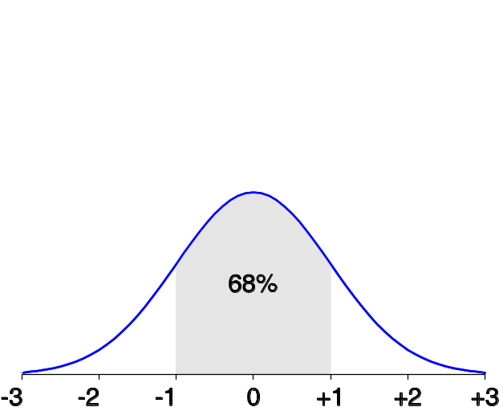
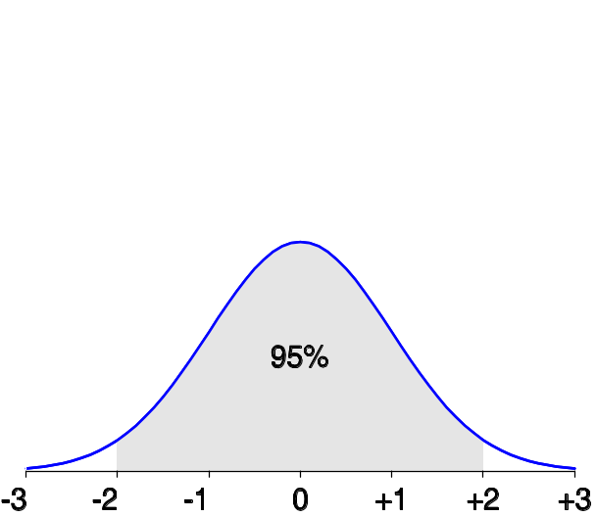
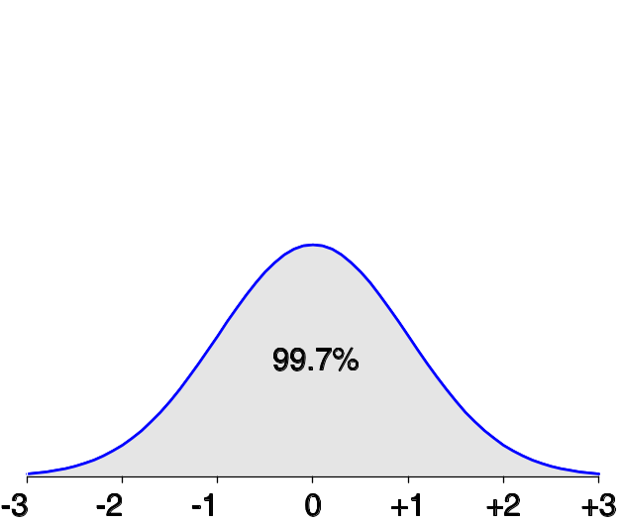
Properties of Normal Distribution Curve
The normal (distribution) curve
  From μ–σ to μ+σ: contains about 68% of the measurements (μ: mean, σ: standard deviation)
  From μ–2σ to μ+2σ: contains about 95% of it
  From μ–3σ to μ+3σ: contains about 99.7% of it
Data Mining: Concepts and Techniques

Slide 11

Boxplot Analysis
Five-number summary of a distribution:
  Minimum, Q1, M, Q3, Maximum
Boxplot
  Data is represented with a box
  The ends of the box are at the first and third quartiles, i.e., the height of the box is IRQ
  The median is marked by a line within the box
  Whiskers: two lines outside the box extend to Minimum and Maximum
Data Mining: Concepts and Techniques

Slide 12

Histogram Analysis
Graph displays of basic statistical class descriptions
  Frequency histograms
    A univariate graphical method
    Consists of a set of rectangles that reflect the counts or frequencies of the classes present in the given data
Data Mining: Concepts and Techniques

Slide 13
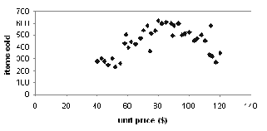
Scatter plot
Provides a first look at bivariate data to see clusters of points, outliers, etc
Each pair of values is treated as a pair of coordinates and plotted as points in the plane
Data Mining: Concepts and Techniques

Slide 14


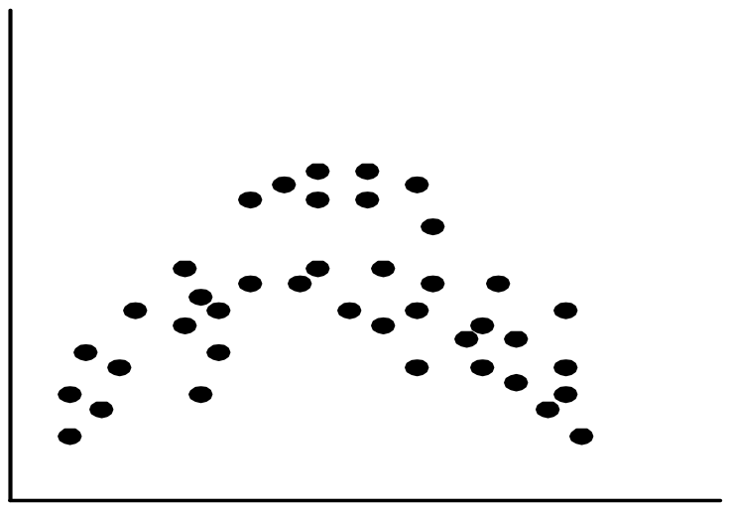
Positively and Negatively Correlated Data
Data Mining: Concepts and Techniques

Slide 15


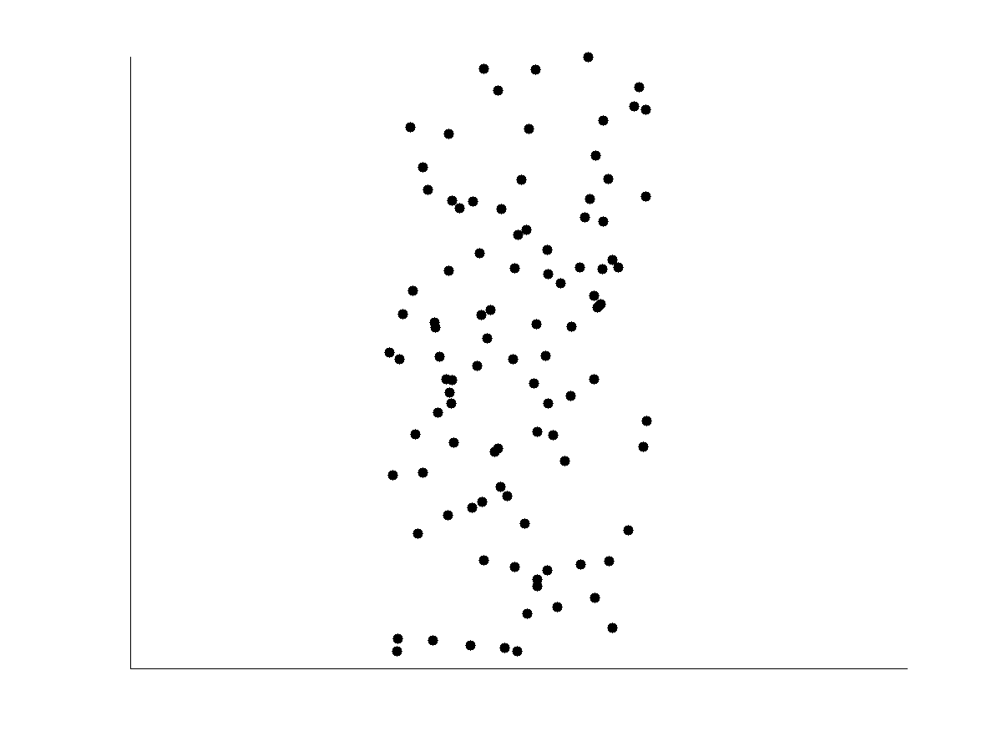
Not Correlated Data
Data Mining: Concepts and Techniques

Slide 16
Chapter 2: Data Preprocessing
Why preprocess the data?
Descriptive data summarization
Data cleaning
Data integration and transformation
Data reduction
Discretization and concept hierarchy generation
Summary
Data Mining: Concepts and Techniques

Slide 17
Data Cleaning
Importance
  “Data cleaning is one of the three biggest problems in data warehousing”—Ralph Kimball
  “Data cleaning is the number one problem in data warehousing”—DCI survey
Data cleaning tasks
  Fill in missing values
  Identify outliers and smooth out noisy data
  Correct inconsistent data
  Resolve redundancy caused by data integration
Data Mining: Concepts and Techniques

Slide 18
Missing Data
Data is not always available
  E.g., many tuples have no recorded value for several attributes, such as customer income in sales data
Missing data may be due to
  equipment malfunction
  inconsistent with other recorded data and thus deleted
  data not entered due to misunderstanding
  certain data may not be considered important at the time of entry
  not register history or changes of the data
Missing data may need to be inferred.
Data Mining: Concepts and Techniques

Slide 19
How to Handle Missing Data?
Ignore the tuple: usually done when class label is missing (assuming the tasks in classification—not effective when the percentage of missing values per attribute varies considerably.
Fill in the missing value manually: tedious + infeasible?
Fill in it automatically with
  a global constant : e.g., “unknown”, a new class?!
  the attribute mean
  the attribute mean for all samples belonging to the same class: smarter
  the most probable value: inference-based such as Bayesian formula or decision tree
Data Mining: Concepts and Techniques

Slide 20
Noisy Data
Noise: random error or variance in a measured variable
Incorrect attribute values may due to
  faulty data collection instruments
  data entry problems
  data transmission problems
  technology limitation
  inconsistency in naming convention
Other data problems which requires data cleaning
  duplicate records
  incomplete data
  inconsistent data
Data Mining: Concepts and Techniques

Slide 21
How to Handle Noisy Data?
Binning
  first sort data and partition into (equal-frequency) bins
  then one can smooth by bin means, smooth by bin median, smooth by bin boundaries, etc.
Regression
  smooth by fitting the data into regression functions
Clustering
  detect and remove outliers
Combined computer and human inspection
  detect suspicious values and check by human (e.g., deal with possible outliers)
Data Mining: Concepts and Techniques

Slide 22
Binning Methods for Data Smoothing
Sorted data for price (in dollars): 4, 8, 9, 15, 21, 21, 24, 25, 26, 28, 29, 34
* Partition into equal-frequency (equi-depth) bins:
- Bin 1: 4, 8, 9, 15
- Bin 2: 21, 21, 24, 25
- Bin 3: 26, 28, 29, 34
* Smoothing by bin means:
- Bin 1: 9, 9, 9, 9
- Bin 2: 23, 23, 23, 23
- Bin 3: 29, 29, 29, 29
* Smoothing by bin boundaries:
- Bin 1: 4, 4, 4, 15
- Bin 2: 21, 21, 25, 25
- Bin 3: 26, 26, 26, 34
Data Mining: Concepts and Techniques

Slide 23
Regression
y
Y1
Y1’
y = x + 1
X1
x
Data Mining: Concepts and Techniques

Slide 24
Regression
Regression is a statistical method used in finance, investing, and other disciplines that attempts to determine the strength and character of the relationship between
  one dependent variable (usually denoted by Y) and a series of other variables (known as independent variables).
Data Mining: Concepts and Techniques

Slide 25
Regression
Regression Analysis – Simple Linear Regression
  Y = a + bX + ϵ
    Where:
    Y – Dependent variable
    X – Independent (explanatory) variable
    a – Intercept
    b – Slope
    ϵ – Residual (error)
Data Mining: Concepts and Techniques

Slide 26
Multiple Linear Regression
Y = a + bX1 + cX2 + dX3 + ϵ
  Where:
    Y – Dependent variable
    X1, X2, X3 – Independent (explanatory) variables
    a – Intercept
    b, c, d – Slopes
    ϵ – Residual (error)
Data Mining: Concepts and Techniques

Slide 27
Cluster Analysis
Data Mining: Concepts and Techniques

Slide 28
Chapter 2: Data Preprocessing
Why preprocess the data?
Data cleaning
Data integration and transformation
Data reduction
Discretization and concept hierarchy generation
Summary
Data Mining: Concepts and Techniques

Slide 29
Data Integration
Data integration:
  Combines data from multiple sources into a coherent store
Schema integration: e.g., A.cust-id ≡ B.cust-#
  Integrate metadata from different sources
Entity identification problem:
  Identify real world entities from multiple data sources, e.g., Bill Clinton = William Clinton
Detecting and resolving data value conflicts
  For the same real world entity, attribute values from different sources are different
  Possible reasons: different representations, different scales, e.g., metric vs. British units
Data Mining: Concepts and Techniques

Slide 30
Handling Redundancy in Data Integration
Redundant data occur often when integration of multiple databases
  Object identification: The same attribute or object may have different names in different databases
  Derivable data: One attribute may be a “derived” attribute in another table, e.g., annual revenue
Redundant attributes may be able to be detected by correlation analysis
Careful integration of the data from multiple sources may help reduce/avoid redundancies and inconsistencies and improve mining speed and quality
Data Mining: Concepts and Techniques

Slide 31
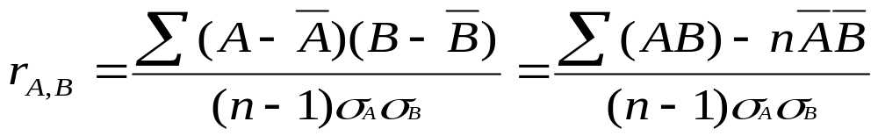


Correlation Analysis
Correlation coefficient (also called Pearson’s product moment coefficient)
  where n is the number of tuples, and are the respective means of A and B, σ_{A} and σ_{B} are the respective standard deviation of A and B, and Σ(AB) is the sum of the AB cross-product.
If r_{A,B} > 0, A and B are positively correlated (A’s values increase as B’s). The higher, the stronger correlation.
r_{A,B} = 0: independent; r_{A,B} < 0: negatively correlated
Data Mining: Concepts and Techniques

Slide 32
Data Transformation
Smoothing: remove noise from data
Aggregation: summarization, data cube construction
Generalization: concept hierarchy climbing
Normalization: scaled to fall within a small, specified range
  min-max normalization
  z-score normalization
  normalization by decimal scaling
Attribute/feature construction
  New attributes constructed from the given ones
Data Mining: Concepts and Techniques

Slide 33





Data Transformation: Normalization
Min-max normalization: to [new_min_{A}, new_max_{A}]
  Ex. Let income range $12,000 to $98,000 normalized to [0.0, 1.0]. Then $73,000 is mapped to
Z-score normalization (μ: mean, σ: standard deviation):
  Ex. Let μ = 54,000, σ = 16,000. Then
Normalization by decimal scaling
Where j is the smallest integer such that Max(|ν’|) < 1
Data Mining: Concepts and Techniques

Slide 34
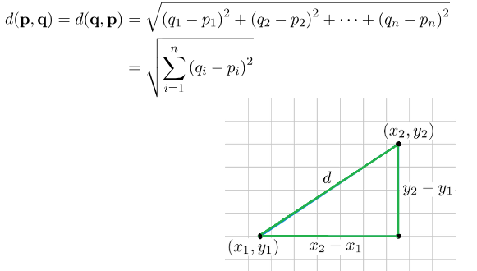
Measures of Distance in Data Mining
Euclidean Distance: Euclidean distance is considered the traditional metric for problems with geometry.
It can be simply explained as the ordinary distance between two points.
It is one of the most used algorithms in the cluster analysis.
Mathematically it computes the root of squared differences between the coordinates between two objects.

Slide 35
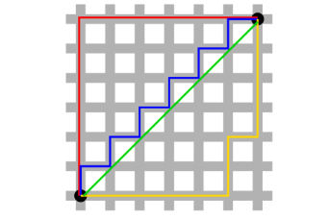
Measures of Distance in Data Mining
Manhattan Distance: This determines the absolute difference among the pair of the coordinates.
Suppose we have two points P and Q to determine the distance between these points we simply have to calculate the perpendicular distance of the points from X-Axis and Y-Axis.
In a plane with P at coordinate (x1, y1) and Q at (x2, y2).
Manhattan distance between P and Q = |x1 – x2| + |y1 – y2|.

Slide 36
Decision Tree Induction
Decision tree induction is the learning of decision trees from class-labeled training tuples.
A decision tree is a flowchart-like tree structure,
  each internal node (non-leaf node) denotes a test on an attribute,
  each branch represents an outcome of the test
  each leaf node (or terminal node) holds a class label.
  The topmost node in a tree is the root node.

Slide 37
Why are decision tree classifiers so popular
The construction of decision tree classifiers does not require any domain knowledge
Decision trees can handle high dimensional data.
Their representation of acquired knowledge in tree form is intuitive and generally easy to assimilate by humans.
The learning and classification steps of decision tree induction are simple and fast.
In general, decision tree classifiers have good accuracy.

Slide 38
Example
Primarily you are given information about:
  Skin colour
  Hair length
  Weight
  Height
Based on the information you can divide the information in such a way that it somehow indicates the characteristics of Males vs. Females.

Slide 39
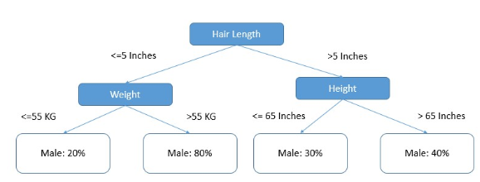
Example

Slide 40
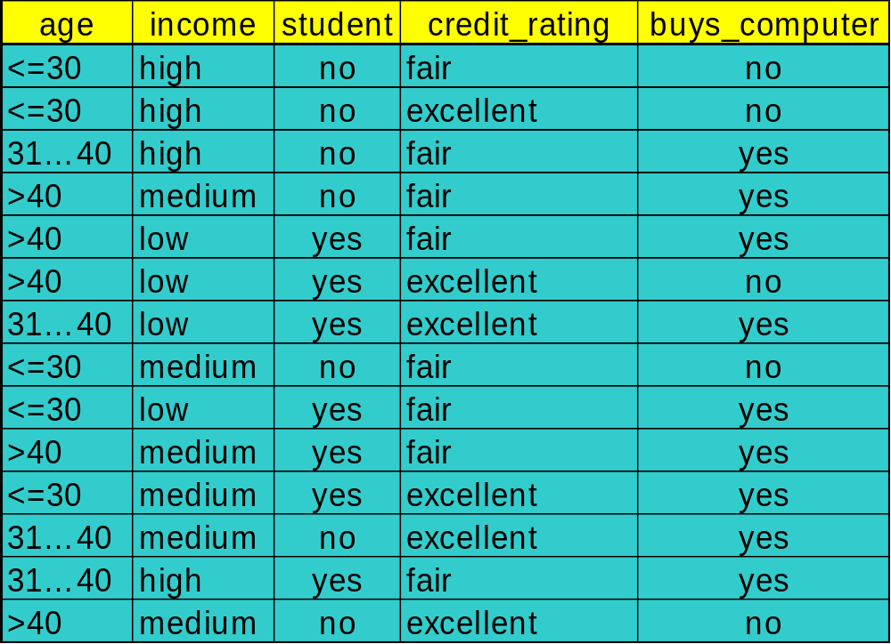
Decision Tree Induction: Training Dataset

Slide 41
Output: A Decision Tree for “buys_computer”
age?
<=30
overcast
>40
31..40
student?
yes
credit rating?
no
yes
excellent
fair
no
yes
no
yes

Slide 42
Algorithm for decision tree
Basic algorithm (a greedy algorithm)
  Tree is constructed in a top-down recursive divide-and-conquer manner
  At start, all the training examples are at the root
  Attributes are categorical (if continuous-valued, they are discretized in advance)
  Examples are partitioned recursively based on selected attributes
  Test attributes are selected on the basis of a heuristic or statistical measure (e.g., information gain)
Conditions for stopping partitioning
  All samples for a given node belong to the same class
  There are no remaining attributes for further partitioning – majority voting is employed for classifying the leaf
  There are no samples left

Slide 43

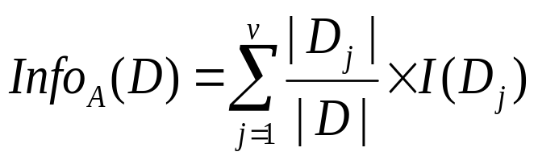

Attribute Selection Measure: Information Gain (ID3/C4.5)
Select the attribute with the highest information gain
Let p_{i} be the probability that an arbitrary tuple in D belongs to class C_{i}, estimated by |C_{i, D}|/|D|
Expected information (entropy) needed to classify a tuple in D:
Information needed (after using A to split D into v partitions) to classify D:
Information gained by branching on attribute A
Data Mining: Concepts and Techniques
Notes:
I : the expected information needed to classify a given sample
E (entropy) : expected information based on the partitioning into subsets by A

Slide 44





Attribute Selection: Information Gain
Class P: buys_computer = “yes”
Class N: buys_computer = “no”
means “age <=30” has 5 out of 14 samples, with 2 yes’es and 3 no’s. Hence
Similarly,
Data Mining: Concepts and Techniques

Slide 45
Disadvantage
A small change in the data can cause a large change in the structure of the decision tree causing instability.
For a Decision tree sometimes calculation can go far more complex compared to other algorithms.
Decision tree often involves higher time to train the model.
Decision tree training is relatively expensive as the complexity and time has taken are more.
The Decision Tree algorithm is inadequate for applying regression and predicting continuous values.
Data Mining: Concepts and Techniques

Slide 46
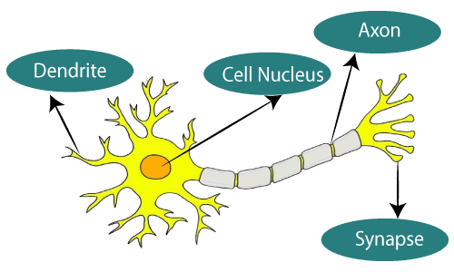
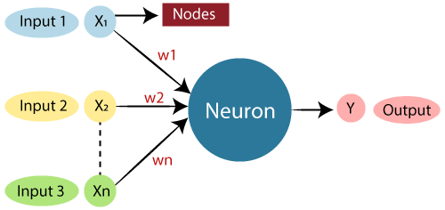
Artificial Neural Network
Data Mining: Concepts and Techniques

Slide 47
ANN
Biological Neural Network | Artificial Neural Network
Dendrites | Inputs
Cell nucleus | Nodes
Synapse | Weights
Axon | Output
Data Mining: Concepts and Techniques

Slide 48
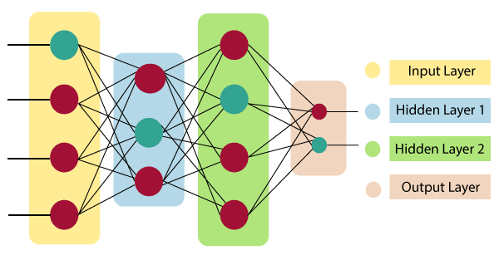
Architecture
Data Mining: Concepts and Techniques

Slide 49

Architecture
Input Layer:
  As the name suggests, it accepts inputs in several different formats provided by the programmer.
Hidden Layer:
  The hidden layer presents in-between input and output layers. It performs all the calculations to find hidden features and patterns.
Output Layer:
  The input goes through a series of transformations using the hidden layer, which finally results in output that is conveyed using this layer.
The artificial neural network takes input and computes the weighted sum of the inputs and includes a bias. This computation is represented in the form of a transfer function.
It determines weighted total is passed as an input to an activation function to produce the output. Activation functions choose whether a node should fire or not. Only those who are fired make it to the output layer.
Data Mining: Concepts and Techniques

Slide 50
Advantages of ANN
Parallel processing capability
Storing data on the entire network
Capability to work with incomplete knowledge
Having fault tolerance

Slide 51
Disadvantages of ANN
Assurance of proper network structure
  There is no particular guideline for determining the structure of artificial neural networks.
  The appropriate network structure is accomplished through experience, trial, and error.
Unrecognized behavior of the network
  ANN produces a testing solution, it does not provide insight
The duration of the network is unknown
The network is reduced to a specific value of the error, and this value does not give us optimum results.

Slide 52
Working of a Neural Network
Forward Propagation
Input Layer: Each feature in the input layer is represented by a node on the network, which receives input data.
Weights and Connections: The weight of each neuronal connection indicates how strong the connection is. Throughout training, these weights are changed.
Hidden Layers: Each hidden layer neuron processes inputs by multiplying them by weights, adding them up, and then passing them through an activation function. By doing this, non-linearity is introduced, enabling the network to recognize intricate patterns.
Output: The final result is produced by repeating the process until the output layer is reached.

Slide 53

Working of a Neural Network
Backpropagation
Loss Calculation: The network’s output is evaluated against the real goal values, and a loss function is used to compute the difference. For a regression problem, the Mean Squared Error (MSE) is commonly used as the cost function.
Loss Function:
Gradient Descent: Gradient descent is then used by the network to reduce the loss. To lower the inaccuracy, weights are changed based on the derivative of the loss with respect to each weight.
Adjusting weights: The weights are adjusted at each connection by applying this iterative process, or backpropagation, backward across the network.

Slide 54
Working of a Neural Network
Training: During training with different data samples, the entire process of forward propagation, loss calculation, and backpropagation is done iteratively, enabling the network to adapt and learn patterns from the data.

Slide 55
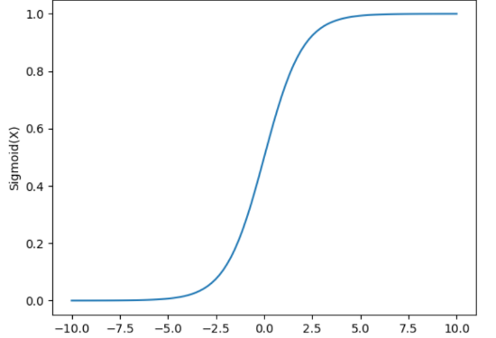
Variants of Activation Function
Linear Function
Equation : Linear function has the equation similar to as of a straight line i.e. y = x
Sigmoid Function
It is a function which is plotted as ‘S’ shaped graph.
Equation : A = 1/(1 + e^{-x})
Value Range : 0 to 1

Slide 56

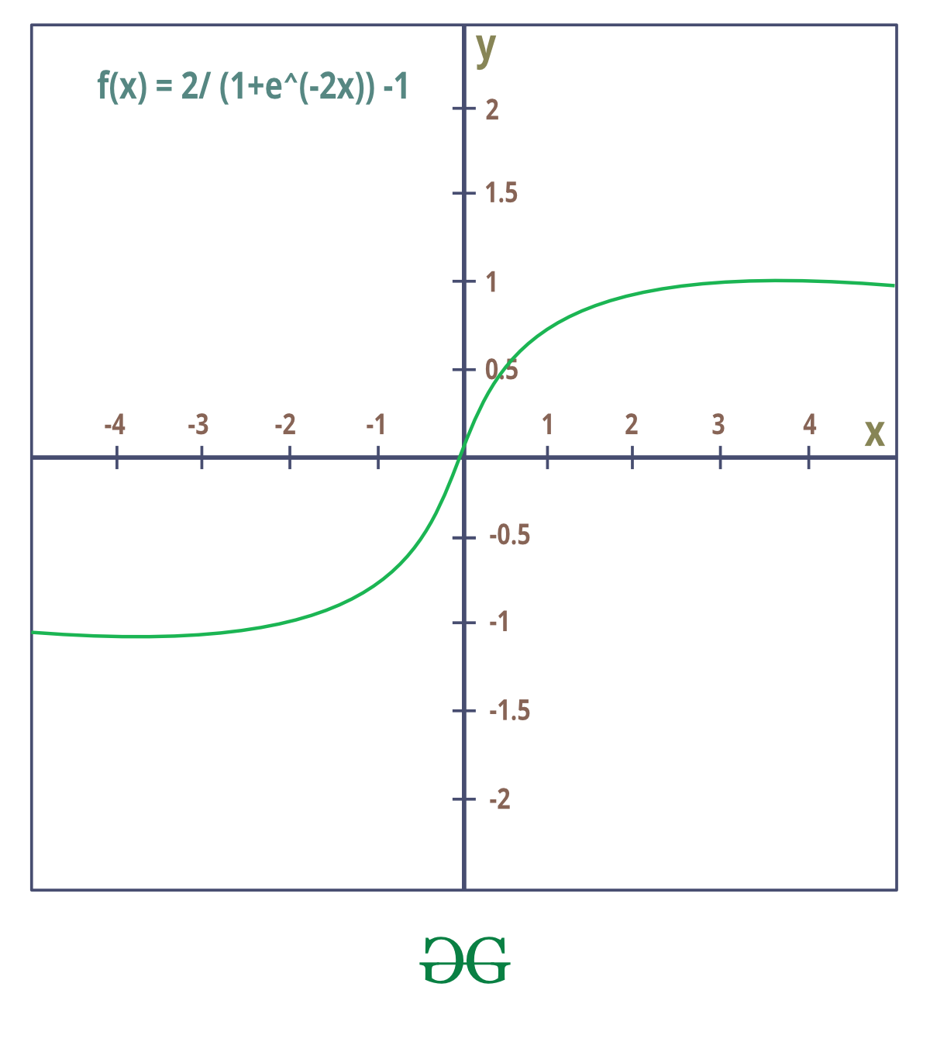
Variants of Activation Function
Tanh Function
  Value Range :- -1 to +1
  Nature :- non-linear

Slide 57
Types of Neural Networks
Feedforward Neteworks:
  A feedforward neural network is a simple artificial neural network architecture in which data moves from input to output in a single direction.
  It has input, hidden, and output layers; feedback loops are absent.
  Its straightforward architecture makes it appropriate for a number of applications, such as regression and pattern recognition.
Multilayer Perceptron (MLP):
  MLP is a type of feedforward neural network with three or more layers, including an input layer, one or more hidden layers, and an output layer.
  It uses nonlinear activation functions.

Slide 58
Types of Neural Networks
Convolutional Neural Network (CNN):
  A Convolutional Neural Network (CNN) is a specialized artificial neural network designed for image processing.
  It employs convolutional layers to automatically learn hierarchical features from input images, enabling effective image recognition and classification.
Recurrent Neural Network (RNN):
  An artificial neural network type intended for sequential data processing is called a Recurrent Neural Network (RNN).
  Recurrent Neural Network(RNN) is a type of Neural Network where the output from the previous step is fed as input to the current step.

Slide 59
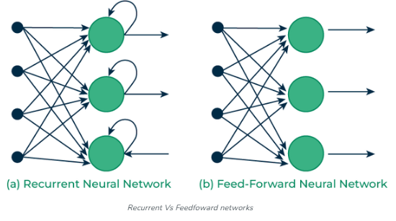
Recurrent Vs Feedfoward networks

Slide 60
Genetic Algorithm
A genetic algorithm is an adaptive heuristic search algorithm inspired by "Darwin's theory of evolution in Nature."
It is used to solve optimization problems

Slide 61
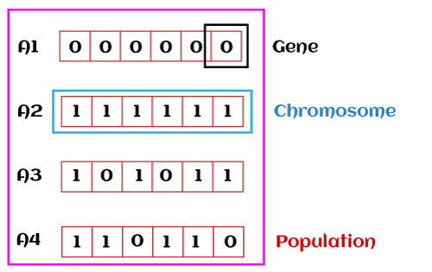
Genetic Algorithm: terminologies
Population:
  Population is the subset of all possible or probable solutions, which can solve the given problem.
Chromosomes:
  A chromosome is one of the solutions in the population for the given problem, and the collection of gene generate a chromosome.
Gene:
  A chromosome is divided into a different gene, or it is an element of the chromosome.

Slide 62
Genetic Algorithm: terminologies
Allele:
  Allele is the value provided to the gene within a particular chromosome.
Fitness Function:
  The fitness function is used to determine the individual's fitness level in the population.
  It means the ability of an individual to compete with other individuals.
  In every iteration, individuals are evaluated based on their fitness function.
Genetic Operators:
  In a genetic algorithm, the best individual mate to regenerate offspring better than parents.
  Here genetic operators play a role in changing the genetic composition of the next generation.

Slide 63
Genetic Algorithm: terminologies
Selection
  After calculating the fitness of every existent in the population,
    a selection process is used to determine which of the individualities in the population will get to reproduce and produce the seed that will form the coming generation.
Types of selection styles available
  Roulette wheel selection
  Event selection
  Rank- grounded selection

Slide 64
How Genetic Algorithm Work
It basically involves five phases to solve the complex optimization problems, which are given as below:
  Initialization
  Fitness Assignment
  Selection
  Reproduction
  Termination

Slide 65
Initialization
The process of a genetic algorithm starts by generating the set of individuals, which is called population.
Here each individual is the solution for the given problem.
An individual contains or is characterized by a set of parameters called Genes.
Genes are combined into a string and generate chromosomes, which is the solution to the problem.
One of the most popular techniques for initialization is the use of random binary strings.

Slide 66
Fitness Assignment
Fitness function is used to determine how fit an individual is?
It means the ability of an individual to compete with other individuals.
In every iteration, individuals are evaluated based on their fitness function.
The fitness function provides a fitness score to each individual.
This score further determines the probability of being selected for reproduction.
The high the fitness score, the more chances of getting selected for reproduction.

Slide 67
Selection
The selection phase involves the selection of individuals for the reproduction of offspring.
All the selected individuals are then arranged in a pair of two to increase reproduction.
Then these individuals transfer their genes to the next generation.
There are three types of Selection methods available, which are:
  Roulette wheel selection
  Tournament selection
  Rank-based selection

Slide 68
Reproduction
After the selection process, the creation of a child occurs in the reproduction step.
  In this step, the genetic algorithm uses two variation operators that are applied to the parent population.
    Crossover
    Mutation

Slide 69
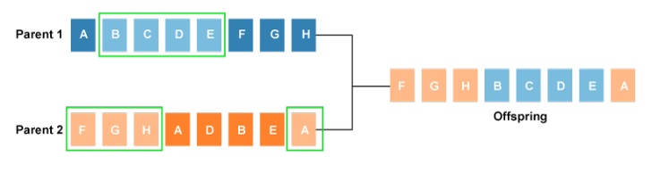
Crossover
The crossover plays a most significant role in the reproduction phase of the genetic algorithm.
  In this process, a crossover point is selected at random within the genes.
  Then the crossover operator swaps genetic information of two parents from the current generation to produce a new individual representing the offspring.

Slide 70
Crossover
The genes of parents are exchanged among themselves until the crossover point is met.
These newly generated offspring are added to the population.
This process is also called or crossover.
Types of crossover styles available:
  One point crossover
  Two-point crossover
  Livery crossover
  Inheritable Algorithms crossover

Slide 71
Mutation
The mutation operator inserts random genes in the offspring (new child) to maintain the diversity in the population.
It can be done by flipping some bits in the chromosomes.
Mutation helps in solving the issue of premature convergence and enhances diversification.
Types of mutation styles available,
  Flip bit mutation
  Gaussian mutation
  Exchange/Swap mutation

Slide 72
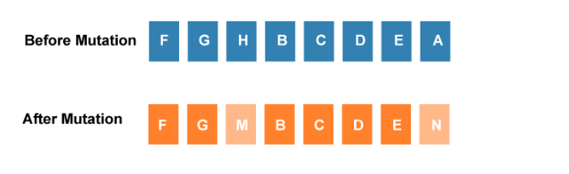
Mutation

Slide 73
Termination
After the reproduction phase, a stopping criterion is applied as a base for termination.
The algorithm terminates after the threshold fitness solution is reached.
It will identify the final solution as the best solution in the population.

Slide 74
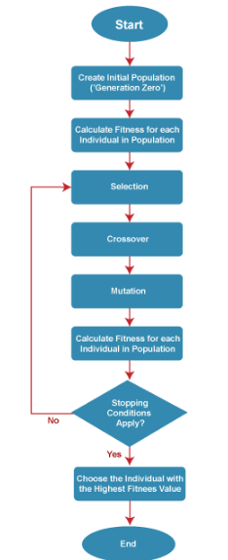
Workflow of a Simple Genetic Algorithm

Slide 75
Advantages of Genetic Algorithm
The parallel capabilities of genetic algorithms are best.
It helps in optimizing various problems such as discrete functions, multi-objective problems, and continuous functions.
It provides a solution for a problem that improves over time.
A genetic algorithm does not need derivative information.

Slide 76
Limitations of Genetic Algorithms
Genetic algorithms are not efficient algorithms for solving simple problems.
It does not guarantee the quality of the final solution to a problem.
Repetitive calculation of fitness values may generate some computational challenges.

